Slide 1




GROUP 14
PROBLEM
DATASETS
LITERATURE REVIEW
OBJECTIVES
METHODOLOGY
WORK PLAN
PLANT DISEASE DETECTION USING ML
PAGE 01
A MACHINE LEARNING APPROACH TO EARLY DETECTION OF PLANT DISEASES

Slide 2
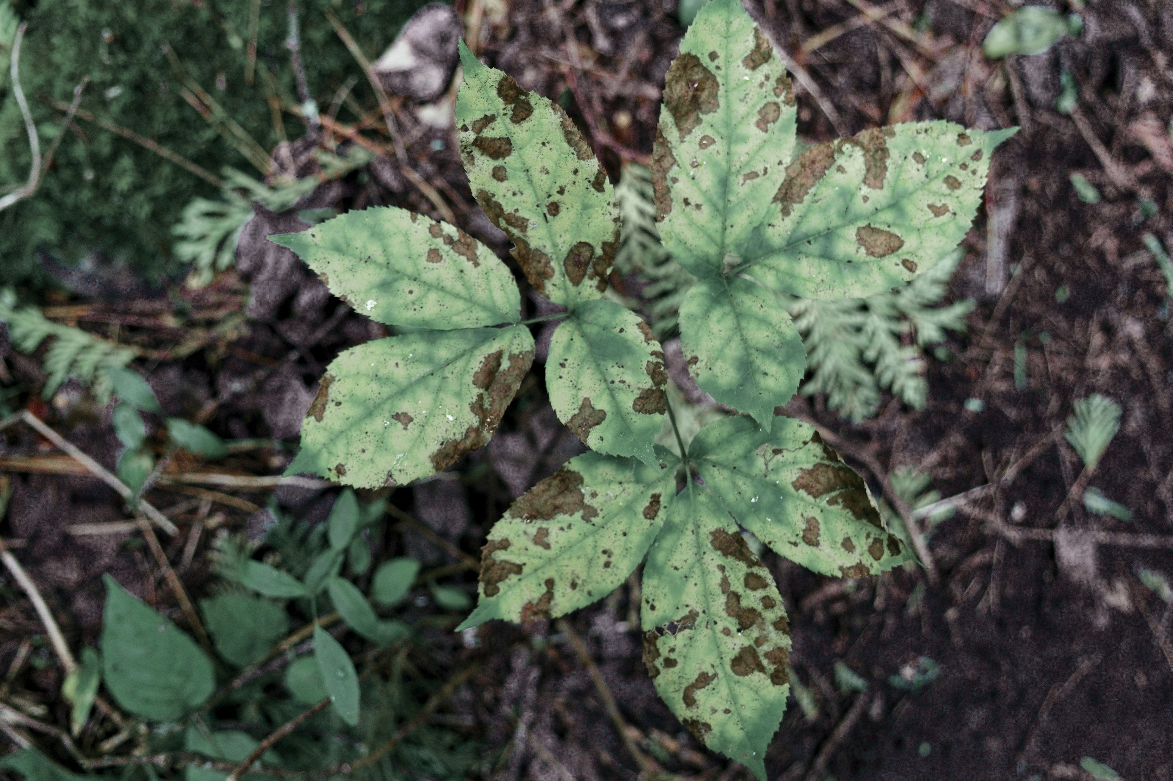

GROUP 14
PROBLEM
DATASETS
LITERATURE REVIEW
OBJECTIVES
METHODOLOGY
WORK PLAN
PROJECT OVERVIEW
Topic Summary
This project focused on early plant disease detection using machine learning, making use of two complementary datasets:
PlantVillage image dataset: for leaf-image-based disease detection
Indoor Plant Health & Growth dataset: for analysing environmental and care factors
The Gap
Crop diseases represent a critical global challenge, causing an estimated 40% average yield loss worldwide and threatening food security for billions of people. Recent advances in machine learning and computer vision have demonstrated significant potential for automating plant disease detection.
This project addressed this gap by developing and comparing machine learning approaches using two complementary datasets: one for image-based disease classification and one for environmental factor analysis
PAGE 02

Slide 3

GROUP 14
PROBLEM
DATASETS
LITERATURE REVIEW
OBJECTIVES
METHODOLOGY
WORK PLAN
PROJECT SCOPE
THE PROJECT INCLUDES:
Building baseline ML models (Decision Tree, Naïve Bayes, k-NN)
Designing and training a CNN using ResNet50 transfer learning
Addressing class imbalance, data preprocessing, EDA, and feature engineering
Comparing results across tabular and image datasets
Producing detailed evaluations (Accuracy, Precision, Recall, F1, RMSE)
PAGE 05

Slide 4
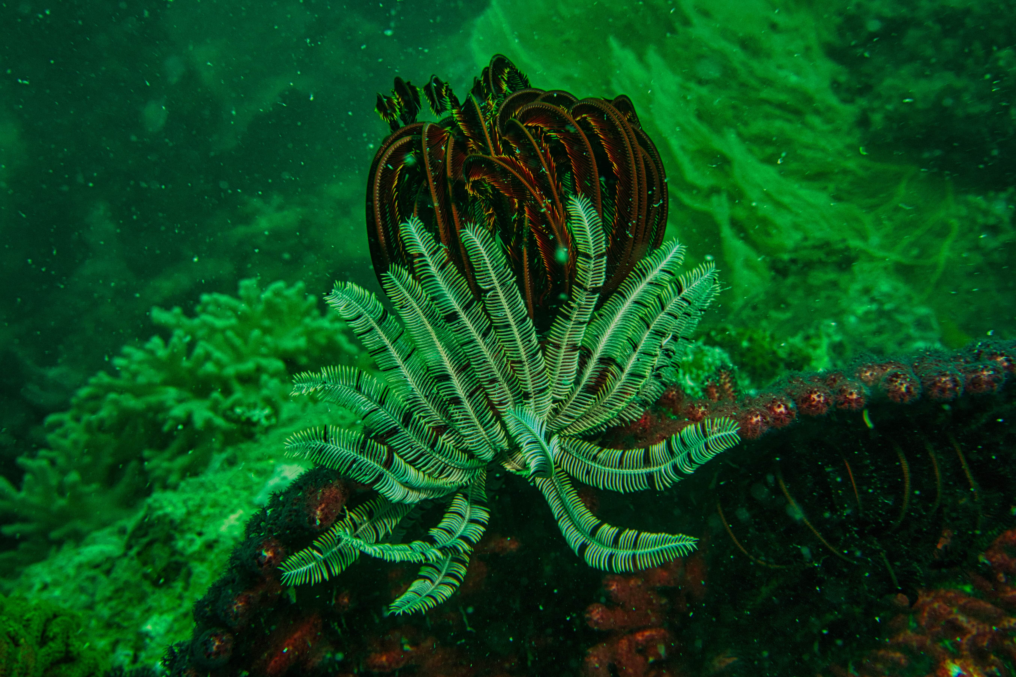




GROUP 14
OVERVIEW
DATASETS
PREPROCESSING
RESULTS
LIMITATIONS
MILESTONES
PROJECT OBJECTIVES
R1: PROJECT TOPIC AND DIRECTION
R2: DATA ANALYSIS AND EXPLORATION
Evaluated classical machine learning models for plant health prediction using tabular data.
Identified early-stage plant diseases to minimize crop losses
Comprehensively conducted data preprocessing & cleaned both datasets.
Exploratory data analysed (EDA) with visualizations.
Implemented clustering to identify patterns in plant health indicators
PAGE 07
R3: BASELINE TRAINING AND EVALUATION
R4: NEURAL NETWORKS
Applied Decision Trees, Naïve Bayes, k-NN and Logistic regression, Algorithms
Evaluated using accuracy, precision, recall, F1-score, and RMSE metrics & compared them.
Assessed baseline image classification performance using classical ML models on raw pixel data.
Implemented and evaluated deep learning models.
CNN with ResNet50 transfer learning for plant disease detection
Analysed limitations, highlighted performance gaps, and identified key directions for future improvements
(feature engineering, better regularisation, fine-tuning)..

Slide 5
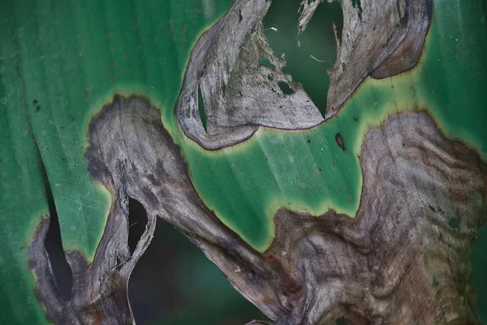
GROUP 14
PROBLEM
DATASETS
LITERATURE REVIEW
OBJECTIVES
METHODOLOGY
WORK PLAN
DATASETS
OVERVIEW
PlantVillage (Image Data)
Indoor Plant Health & Growth (Tabular Data)
The dataset contains:
Approximately 20,600 labeled leaf images across seven disease categories (Potato Healthy, Potato Early Blight, Potato Late Blight, Tomato Healthy, Tomato Early Blight, Tomato Late Blight, Tomato Bacterial Spot).
Images are RGB color photographs of infected and healthy leaves, ideal for visual disease classification using deep learning.
This dataset contains:
1,000 observations with 16 numerical and categorical features describing environmental conditions and plant care factors (e.g., temperature, humidity, watering frequency, sunlight exposure, soil type).
With target variable being Health_Score ranging from 1 (dying) to 5 (thriving), enabling multi-class classification of plant health status based on environmental attributes.
PAGE 03

Slide 6

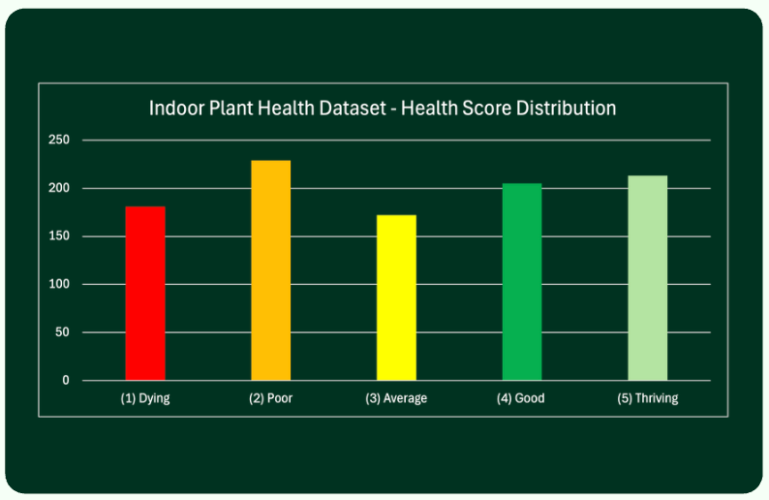
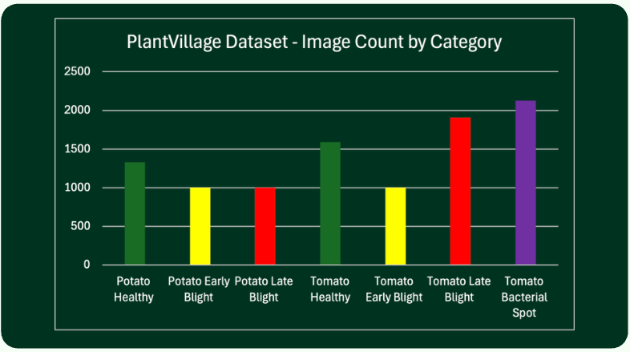
GROUP 14
PROBLEM
DATASETS
LITERATURE REVIEW
OBJECTIVES
METHODOLOGY
WORK PLAN
DATASET JUSTIFICATION
Both datasets were selected because they directly address our research objectives: image-based disease detection and environmental factor analysis for plant health prediction. The PlantVillage dataset is widely used in plant disease research, with prior work achieving >95% accuracy, establishing a strong benchmark. The tabular dataset provides complementary environmental insights often overlooked in image-only approaches.
PAGE 09

Slide 7
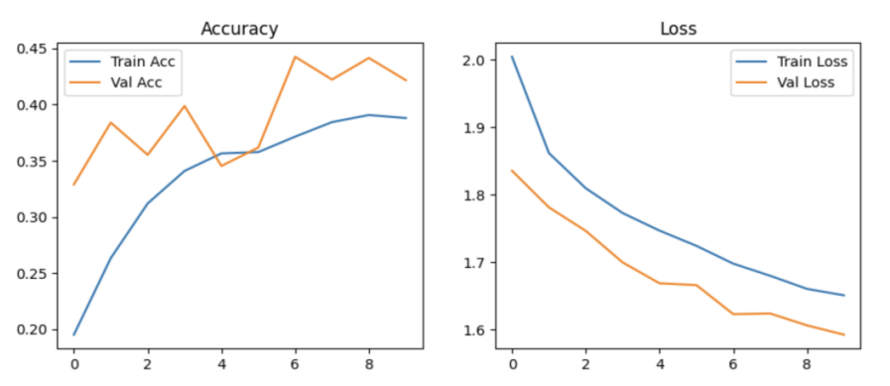
GROUP 14
PROBLEM
DATASETS
LITERATURE REVIEW
OBJECTIVES
METHODOLOGY
WORK PLAN
PREPROCESSING STEPS
IMAGE DATA PREPROCESSING
1) Standardization & Validation:
Resized all images to 224×224 pixels and converted to RGB color space for CNN compatibility.
2) Normalization:
Scaled pixel values from [0, 255] to [0, 1] to accelerate neural network convergence [7].
3) Data Augmentation:
Increasing Potato Healthy from 152 to ~1,300 images (8.5× increase).
4) Train/Test Split:
Stratified split into 70% training and 30% testing to maintain class distribution and prevent data leakage.
PAGE 06
CNN Training History (Accuracy and Loss)

Slide 8



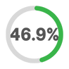
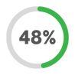





GROUP 14
PROBLEM
DATASETS
LITERATURE REVIEW
OBJECTIVES
METHODOLOGY
WORK PLAN
IMAGE DATA METRICS
Naive Bayes
PAGE 07
Classification Accuracy
Precision
F1-Score
Recall for Critical Diseases
Decision Tree
Classification Accuracy
Precision
F1-Score
Recall for Critical Diseases
k-Nearest Neighbors
(kNN)
Classification Accuracy
Precision
F1-Score
Recall for Critical Diseases

Slide 9
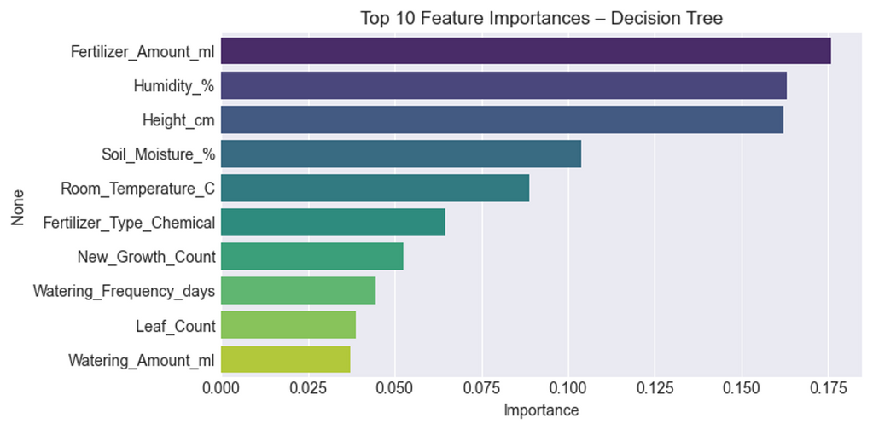
GROUP 14
OVERVIEW
DATASETS
PREPROCESSING
RESULTS
LIMITATIONS
MILESTONES
PREPROCESSING STEPS
TABULAR DATA PREPROCESSING
1) Missing Value Handling
Applied median imputation for numerical features and mode imputation for categorical features.
2) Categorical Encoding:
One-hot encoded the 7 categorical variables
3) Feature Scaling:
Standardized numerical features using z-score to ensure equal feature contribution.
4) Feature Selection:
Used Random Forest importance ranking to select top 25 features from 58, reducing dimensionality while preserving predictive power.
5) Class Balancing:
Applied hybrid SMOTE combined with undersampling, increasing minority classes while reducing majority classes, transforming the imbalance ratio from 4.25:1 to 1.3:1
PAGE 06
Top 10 Feature Importance for the Decision Tree

Slide 10



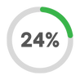







GROUP 14
PROBLEM
DATASETS
LITERATURE REVIEW
OBJECTIVES
METHODOLOGY
WORK PLAN
TABULAR DATA METRICS
Logistic Regression
1.858
PAGE 07
Classification Accuracy
Precision
F1-Score
Recall for Critical Diseases
Root Mean Squared Error
(RMSE)
Decision Tree
1.937
Classification Accuracy
Precision
F1-Score
Recall for Critical Diseases
Root Mean Squared Error
(RMSE)
k-Nearest Neighbors
(kNN)
2.057
Classification Accuracy
Precision
F1-Score
Recall for Critical Diseases
Root Mean Squared Error
(RMSE)

Slide 11
GROUP 14
OVERVIEW
DATASETS
PREPROCESSING
RESULTS
LIMITATIONS
MILESTONES
KEY INSIGHTS & APPLICATION
Insights:
The Naive Bayes model provided a surprisingly strong baseline (65.45% accuracy), indicating that simple pixel statistics hold some value.
The CNN, despite achieving a modest 42.0% accuracy in the initial 10-epoch run, represents a significant leap over the classical models.
Finally, the PlantVillage image dataset demonstrated the clear potential of deep learning, with the CNN model significantly outperforming all exploratory baselines.
Applicability:
These systems offer the possibility of rapid, smartphone-based diagnosis, enabling farmers to take preventive action before disease spreads.
The outcomes of this work have direct applications for agricultural technology, enabling accessible diagnostic tools for farmers worldwide.
PAGE 09

Slide 12

GROUP 14
OVERVIEW
DATASETS
PREPROCESSING
RESULTS
LIMITATIONS
MILESTONES
LIMITATIONS & MITIGATIONS
Limitations:
Tabular dataset too small (1,000 rows) and lacks key attributes
CNN trained for only 10 epochs → underfitting
Visual similarity between disease classes affects CNN performance
Imbalance persists despite augmentation
Mitigations:
Increased the number of training epochs, implemented for more aggressive regularization (e.g., L2 regularization, early stopping), and fine-tuned the pre-trained ResNet50 layers to better adapt the model to the specific features of plant disease images.
For tabular, there was an imbalance in class, so SMOTE was applied, the imbalance ratio was from 4.25:1 to 1.3:1, and also for overfitting, we narrowed down the features from 58 to 25 (samples per feature was 12.1:1 and now is 28.0:1)
PAGE 08

Slide 13
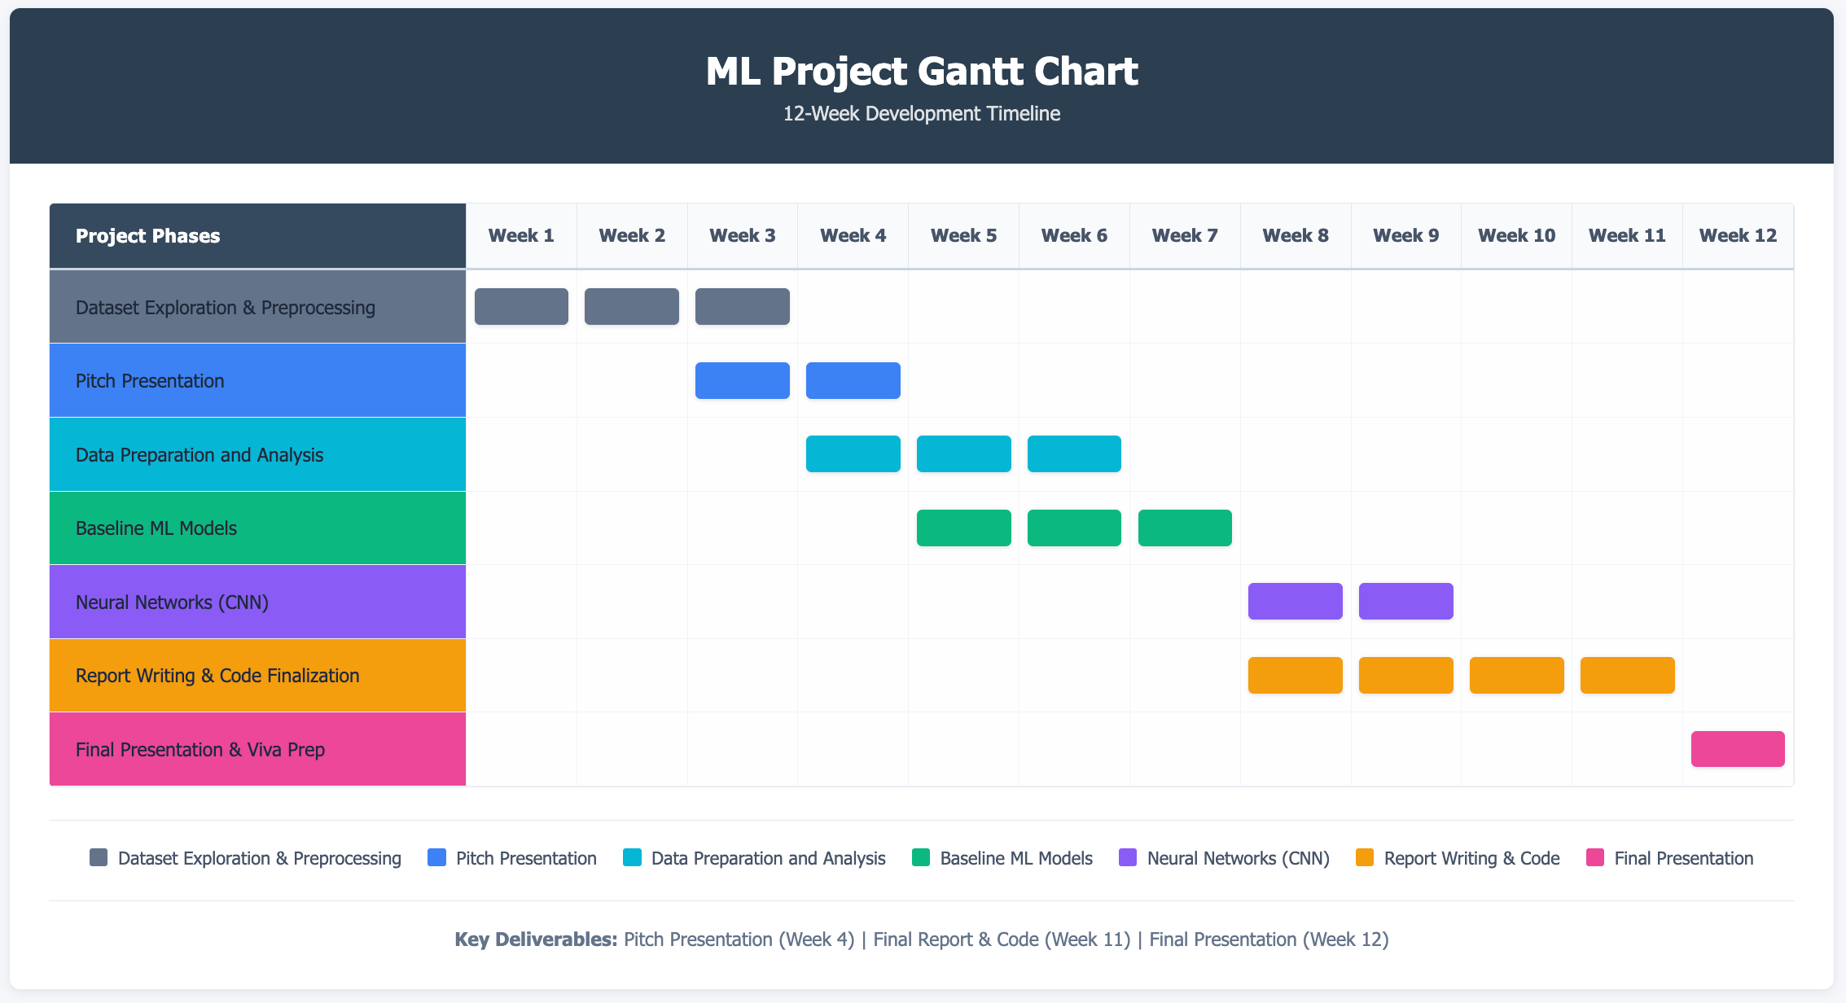
GROUP 14
OVERVIEW
DATASETS
PREPROCESSING
RESULTS
LIMITATIONS
MILESTONES
PROJECT MILESTONES
PAGE 10

Slide 14






GROUP 14
OVERVIEW
DATASETS
PREPROCESSING
RESULTS
LIMITATIONS
MILESTONES
GROUP COLLABORATION
Througout this project, the team maintained a clear milestone driven workflow. We utilized Github & Google Doc, to keep updated with the working of the project. Furthermore, we used Teams to hold online meetings to update the work completed and to discuss future steps.
We began by aligning our direction on R1 by selecting two complementary datasets and progressed through R2 by splitting responsibilities between three members for the exploration and preprocessing. Whereby, the EDA was conducted by a fourth member.
During the R3 baseline model development phase, group members were further divided to conduct Logistic Regression, Decision Tree, k-NN, Naïve Bayes between two members. For R4, the deep learning milestone, one member was assigned to implement the CNN with ResNet50 transfer learning.
Finally, One member focused on compiling the findings while discussing the results with the other members to finalize the report and another member collaborated by presenting these findings and designing the pitch into a presentable format. This systematic distribution of modelling tasks allowed us to cover a wider algorithmic space within the project timeframe.
PAGE 10
WEEK 1
WEEK 3
WEEK3
WEEK4
WEEK 7
WEEK 9
WEEK 11
WEEK 12
Forming Group & Identifying Topic and Datasets
Entire Group
Dataset exploration & preprocessing
Saad | Hassan
Sufyaan
Exploratory Data Analysis (EDA)
Sharaf
Initial Presentation
Sharaf
Baseline
ML models
(Decision Trees, Naïve Bayes, kNN)
Saad | Abdullah
Neural networks (CNN for images)
Hassan | Sufyaan
Complete report writing + code finalization (GitHub)
Sufyaan
Final presentation
Sharaf

Slide 15

GROUP 14
OVERVIEW
DATASETS
PREPROCESSING
RESULTS
LIMITATIONS
MILESTONES
REFERENCES
Singh, G., & Yogi, K. K. (2023).Performance evaluation of plant leaf disease detection using deep learning models.Archives of Phytopathology and Plant Protection, 56(3), 209–233. https://doi.org/10.1080/03235408.2023.2183792
PlantVillage Dataset. (n.d.). Kaggle. Retrieved from https://www.kaggle.com/datasets/emmarex/plantdisease
Indoor Plant Health & Growth Dataset. (2023). Kaggle. Retrieved from https://www.kaggle.com/datasets/souvikrana17/indoor-plant-health-and-growth-dataset
Food and Agriculture Organization of the United Nations. (2021).International Year of Plant Health. Retrieved from http://www.fao.org/plant-health-2020/about/en/
UN Food and Agriculture Organization. (2019).World Food and Agriculture – Statistical Pocketbook 2019. Retrieved from https://www.fao.org/sustainability/news/detail/en/c/1274219/
PAGE 11

Slide 16

GROUP 14
OVERVIEW
DATASETS
PREPROCESSING
RESULTS
LIMITATIONS
MILESTONES
THANK YOU!
PAGE 12
ANY FEEDBACK, WOULD BE APPRECIATED

